Slide 1
STLC Process
Software Testing Life Cycle
SQA: Manual & Automated Testing

Slide 2
What is STLC?
Software Testing Life Cycle (STLC) illustrates the phases of testing that a certain piece of software must go through in order to meet certain specified quality requirements
STLC is a part of the software development life cycle (SDLC) in which testing takes place
Testing team prepares to test, executes the testing and reflects on the testing process
STLC allow a software development team takes to ensure their product is high quality and error-free before delivering it to the client and users.

Slide 3
Benefits of STLC
Structured Approach: Provides a clear, systematic process for testing, ensuring no phase is overlooked.
Early Defect Detection: Identifies issues in the early stages, reducing cost and time for fixes.
Improved Test Coverage: Ensures all requirements are thoroughly tested, minimizing risks of missed scenarios.
Enhanced Collaboration: Encourages coordination between developers, testers, and stakeholders for better outcomes.
Quality Assurance: Guarantees a high-quality software product by following a disciplined testing process..

Slide 4
Benefits of STLC…cont
Defined Roles and Responsibilities: Clarifies tasks for each phase, improving accountability and efficiency.
Scalability and Reusability: Facilitates test case reuse and scalability for future testing needs.
Better Resource Management: Optimizes the use of time, tools, and human resources during testing.
Informed Decision-Making: Provides detailed documentation and reports, aiding stakeholders in making data-driven decisions.
Customer Satisfaction: Ensures a reliable, bug-free product, improving end-user experience and trust.

Slide 5
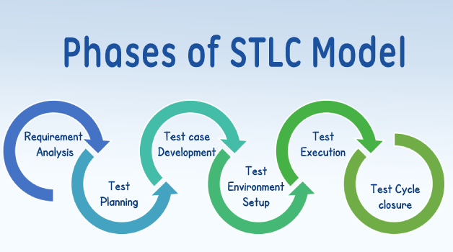
Phases of the STLC
Requirement Analysis
Test Planning
Test Case Development
Test Environment Setup
Test Execution
  Defect tracking
Test Cycle Closure

Slide 6
Requirement Analysis
Studies and analyzes the requirements from a testing perspective.
Identify testable requirements.
Collaboration between testers and stakeholders.
From overall to unit feature with WH questions
Requirement analysis can be done from any formal documents/email/chat history/hand note/sketch etc.
Formal documents can be: PRD (Product Requirement Document), BRD (Business Requirement Document), SRS (Software Requirements Specification) etc. EXAMPLE
Notes:
A PRD (Product Requirements Document) outlines the specific features, functionalities, and requirements of a product. A BRD (Business Requirements Document) focuses on the broader business needs, objectives, and goals that the product aims to address. An SRS (Software Requirements Specification) provides detailed technical specifications for the software development team to build the product.
In essence:
PRD: What the product is and how it should work.
BRD: Why the product is being built and what business needs it addresses.
SRS: How the product will be built technically.

Slide 7
Test Planning
The testing team creates a testing strategy and plan.
Defines scope, objectives, resources, and schedule for testing activities.
Test effort estimation and risk analysis.
Test plan document (URL)

Slide 8
Summary
What is STLC
Benefits
Phases
Requirement Analysis
Test Planning

Slide 9
Test Case Development
Test cases are created based on the requirements and planning.
Writing detailed test cases and test scripts.
Prioritizing test cases (e.g., functional, boundary, negative test cases).
Priority can be defined by: High, Medium, Low or P1 > P2 > P3 or Fibonacci number series (1 > 2 > 3 > 5 > 8 > … decreasing priority as numbers grow)
Test case sample - short (URL)

Slide 10
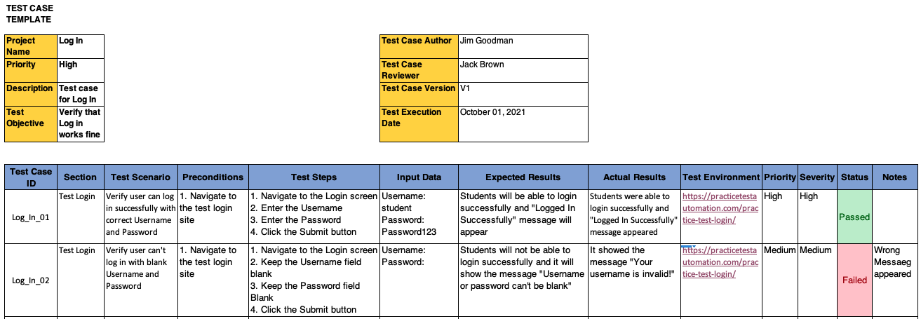
Sample Test Case
Details Test Case Template (URL)
Test URL: https://practicetestautomation.com/practice-test-login/

Slide 11
Checklist
A structured list of cases or tasks used to ensure thorough coverage and systematic verification created based on the test cases
It acts as a guide, helping others (specially the development team) to remember all the necessary checks and ensuring that no critical step is missed
Prepared to reduce back and forth of features between Dev Team and QA Team
Checklist document (URL)
Testing URL: https://www.startech.com.bd/

Slide 12
Test Environment Setup
Set Environment according to the need (Ex: Test URL/Server)
Set dataset (Ex: Different size/format files for File Upload)
Set operating system, or device according to the testing configuration (Android/iOS version)
Preparing APIs and Variables, values etc

Slide 13
Test Execution
Executing the prepared test cases in the test environment.
Logging defects for any test case failures.
Tracking the progress of test execution and comparing with expected results.
Re-testing the reported issue after fix
Test case sample - short (URL)

Slide 14
Severity and Priority of Test Cases:
Severity: Severity in test cases measures the impact if this test case fails and what will be the impact on the system if this test scenario does not work
  Categories: Critical, Major, Medium, Low etc
Priority: Priority of a test case measures how important it is to execute that test case from a business or release perspective and which test cases must be executed first
  Categories: High, Medium, Low etc
Test Case | Priority | Severity
Valid login | High | Critical
Invalid password | High | High
Remember me | Medium | Medium
UI alignment | Low | Low

Slide 15
Summary
Test Case Development
Checklist
Test Environment Setup
Test Execution

Slide 16
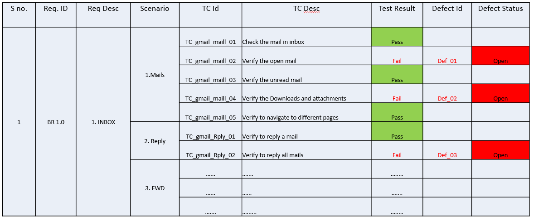
Traceability Matrix (TM)
Also known as a Requirements Traceability Matrix (RTM)
Test cases are mapped with the corresponding requirement to ensure the coverage of test cases, to find any gap between requirements specifications and test cases
Typically created during or before the testing phase

Slide 17
Defect Tracking
Recording any defects found during test execution.
Defect severity, priority, and tracking life cycle.
Retesting the defects after resolution.

Slide 18
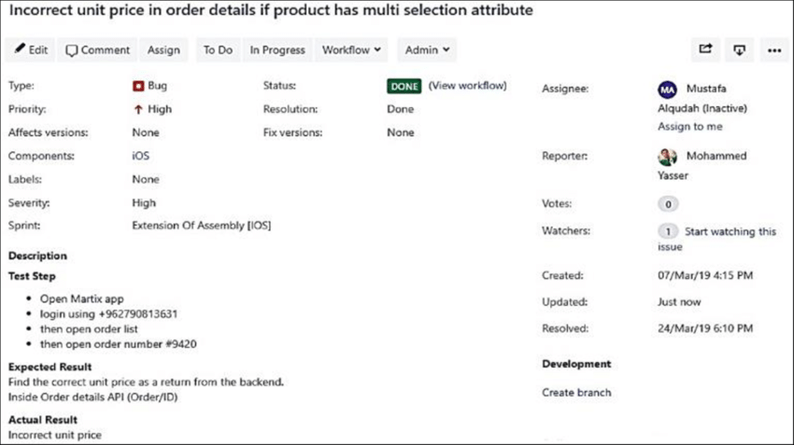
Sample Defect/Issue/Bug Report

Slide 19
Severity and Priority of Defect/Issue/Bug:
Severity: Severity measures a bug's technical impact on software functionality, which relates to the quality standard by Tester or QA
  Categories: Critical, Major, Medium, Low
Priority: Priority indicates its urgency and order for fixing, considering business needs and user impact which relates to the scheduling to resolve the problem by PM or BA
  Categories: High, Medium, Low
For example, a high-severity bug that crashes the application must be fixed immediately (high priority), but a minor typo (low severity) might also be high priority if it appears on the company's logo and affects brand image.

Slide 20
Example of Severity and Priority:
High Severity & High Priority: Let’s say, there is a web application where, after providing the login details, the user can’t click the login button
High Severity & Low Priority: Again consider the above example, but this time it’s occurring on the older versions of Internet Explorer say IE8
Low Severity & Low Priority: In the help or faq section of the website, the theme or font style or font size of a section of the page does not match with the rest of the page
Low Severity & High Priority: When there is a typo on the website. For example, the case of the school website where the 'Admission Form' is misspelled as 'Admision From'.

Slide 21
Test Cycle Closure
Test completion and closure activities.
Preparing the test summary report.
Ensuring all test cases are executed and defects are resolved or deferred.
Make release note for the deployment (URL)

Slide 22
Testing as a process within the Software Development process
Depending on the approach chosen, testing will take place at different points within the development process
Testing is a process itself
The testing process is determined by the following phases
  Test planning
  Test analysis and test design
  Test implementation and test execution
  Evaluating Exit Criteria and reporting
  Test closure activities
As well as
  Test Controlling (at all phases)

Slide 23
Exit criteria:
Exit criteria (after Glib and Graham):
  The set of generic specific conditions, agreed upon with the stakeholders, for permitting a process to be officially completed.
  The purpose of exit criteria is to prevent a task from being considered completed when there are still parts of the task outstanding which have not been finished.
  Exit criteria are used to report against and to plan when to stop testing. This should be done for each test level.

Slide 24
Evaluating Exit Criteria-main tasks:
Assessing test execution against the defined objectives
  E.g. test execution and criteria
Evaluating test logs
  Summary of test activities, test result , communication exit criteria
Provide information to allow the decision, whether more test should take place

Slide 25
Test Closure Activities - main task
Collection data from completed test activities to consolidate experience , test ware , facts and numbers.
Closure of incident reports or raising change requests for any remaining open points
Checking which planned deliverables have been delivered and tested.
Documenting the acceptance of the system
Finalizing and archiving test ware, the test environment and the test infrastructure for later reuse, hand over to operations
Analyzing “lessons learned” for future project

Slide 26
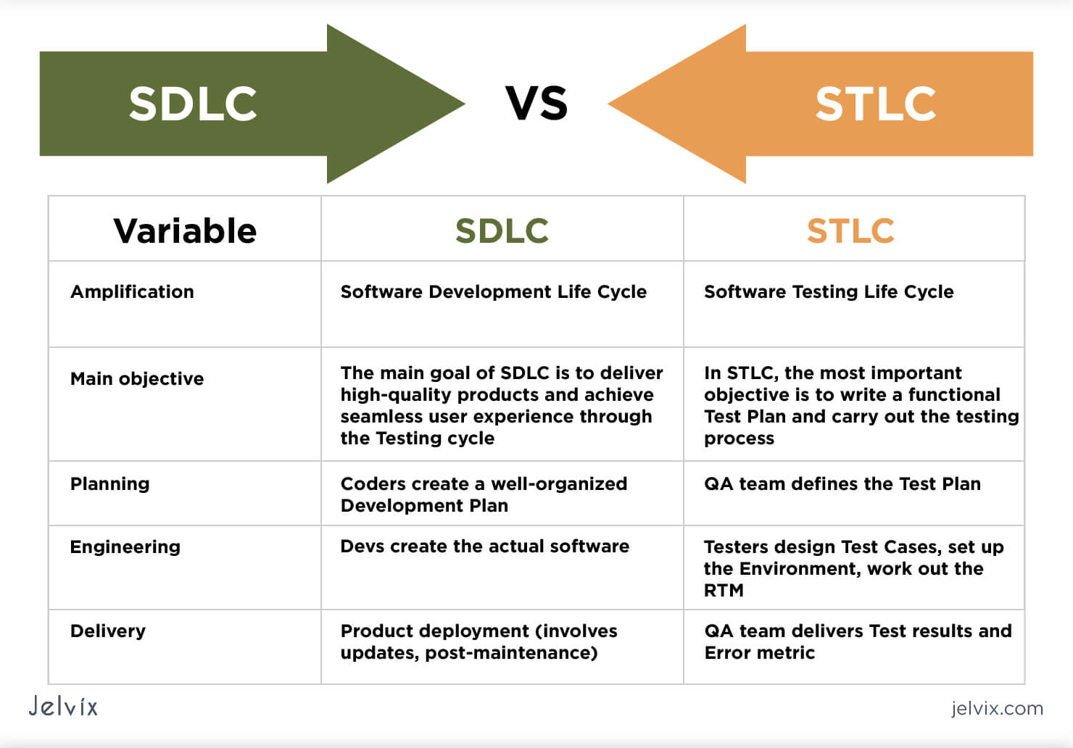
SDLC vs STLC differences

Slide 27

Any Questions?
Thank you!

